Slide 1
Hotel Laundry Optimization
Antalya Bilim University
Aybüke Şahin
Semail Ülgen
Seçil Gülbudak Dil
Notes:
Hello everyone, I'm Aybüke. I'm a student of Industrial Engineering at Antalya Bilim University. Today, I will talk to you about my graduation project. I worked on this project with Associate Professor Semail Ülgen and Seçil Gülbudak Dil.

Slide 2
Contents
Antalya: A Paradise of History and Sun
Problem Statement & Objectives
Solution Techniques & Methods
Further Research
Notes:
In this presentation, ı wil talk about Hotel Laundry Optimization. Our contens will be proceed
Antalya:
A Paradise of History and Sun
Problem Statement & Objectives
Solution Techniques & Methods
And finally
Further research

Slide 3
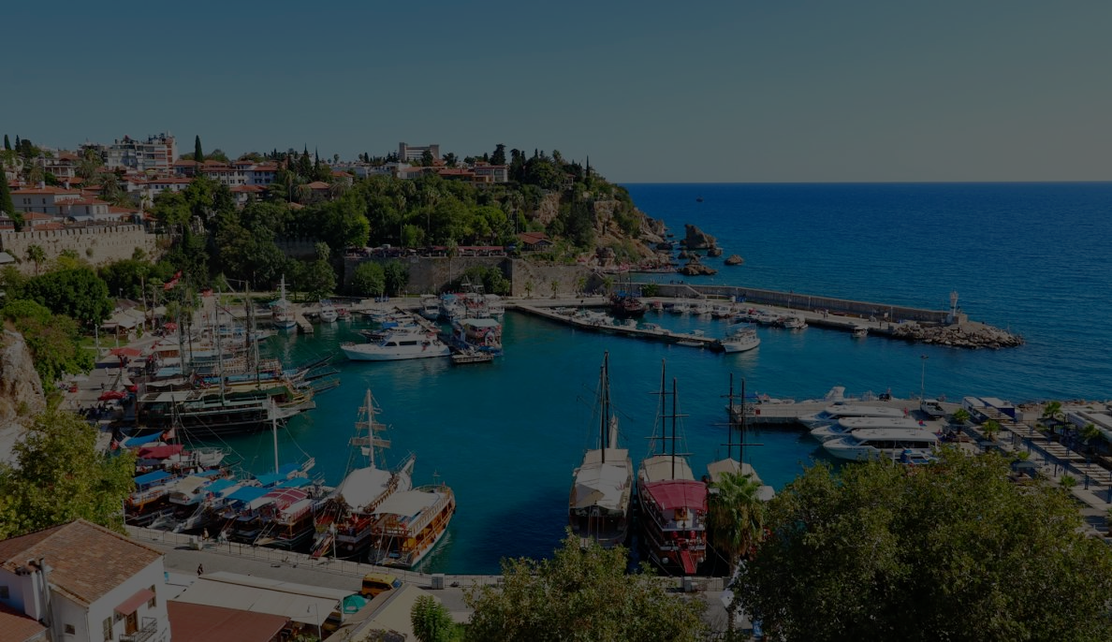
Antalya
Antalya
GDP of Antalya, 2022 | 30,5 million $
GDP Share of Antalya in Turkey | 3%
GDP Share of Service of Antalya | 72% (More than %50 is Tourism)
Total number of incoming tourists to Turkey, 2022 | 50,5 million people
Total tourism income of Turkey, 2022 | 41,2 billion $
Total number of incoming tourists to Antalya, 2023 | 15,7 million people
Notes:
Let me tell you a bit about Antalya
Due to its status as the tourism capital of Turkey, Antalya contributes significantly to the city and the country's economy. With its favorable climate, diverse nature, and rich cultural and historical heritage, Antalya offers a wide range of alternative tourism options. The city continues to maintain its position as the top contributor to Turkey's tourism revenue. The unique blend of natural beauty and cultural attractions makes Antalya a preferred destination, attracting visitors from around the world and ensuring a sustained economic impact on both the local and national levels.
Welcome to our overview of Antalya's economic landscape. Here, we'll explore key statistics such as Antalya's GDP, its share within Turkey's economy, the dominance of its service sector—especially tourism—along with vital tourism data for both Antalya and Turkey as a whole. Let's delve into the numbers shaping Antalya's economic significance.
The total number of incoming tourists to Turkey is 50 (fifty )million people, and the total number of incoming tourists to Antalya is 15.7 million people. Turkey has 81 provinces, but as we can understand from this, more than 30% of tourists come to Antalya.

Slide 4




Importance of the research
Tourism accounts for more than 50% of service GDP in Antalya.
More than 60% of the tourism GDP in Antalya is generated by all-inclusive hotels.
Approximately 3% of the total annual cost of a hotel is used for laundry services.
This corresponds to an annual cost of approximately 750 thousand Euros.
Therefore, it is important to manage the process correctly.
Notes:
Therefore, tourism is very important in Antalya. At this point, solving the problem will not only be for Antalya but also for 30% of Turkey's tourism.
Even from here, the importance of research can be understood. However, if we want to elaborate further:

Slide 5




What is the problem?
Some of these expectations are that
washing the towels and sheets they use
the tablecloths used on the tables
where they eat are clean etc.
The aim of this project is to decide whether the laundry washing operation should be carried out within the facility or through outsourcing for more efficient execution.
Notes:
In all-inclusive concept hotels, guests want to relax without thinking about anything during their holiday. In this context, one of the first services they want to receive is cleaning.

Slide 6
Objectives of the research
Service quality
Customer satisfaction
Laundry budget
Workflow in external departments
Efficiency of laundry operation
Notes:
The objectives of the research include;
Assessing and improving the quality of service provided.
Measuring and enhancing the satisfaction levels of customers.
Analyzing and minimazing the budget allocated for laundry services.
Evaluating the efficiency of processes in external departments related to laundry services.
Assessing and optimizing the overall efficiency of laundry operations.

Slide 7
1. Determination of the Current Situation:
· Identification of existing capacity
· Costs
2. Analysis of the Possibility of Conducting Outsourced Services Within the Facility:
· Determination of necessary capacity (machinery, equipment, personnel, etc.)
· Scheduling
· Required laundry area size
3. Solving problem
4. Further Research
Stages of this Project
Notes:
Now I will show you the stages of this project
There are essentially two stages in this project: Determination of the Current Situation, Analysis of the Possibility of Conducting Outsourced Services Within the Facility.
Later I will mention you how we can solve the proplem and further research

Slide 8
Determination of the Current Situation
Notes:
Let me talk about determination of the curre
nt situation

Slide 9
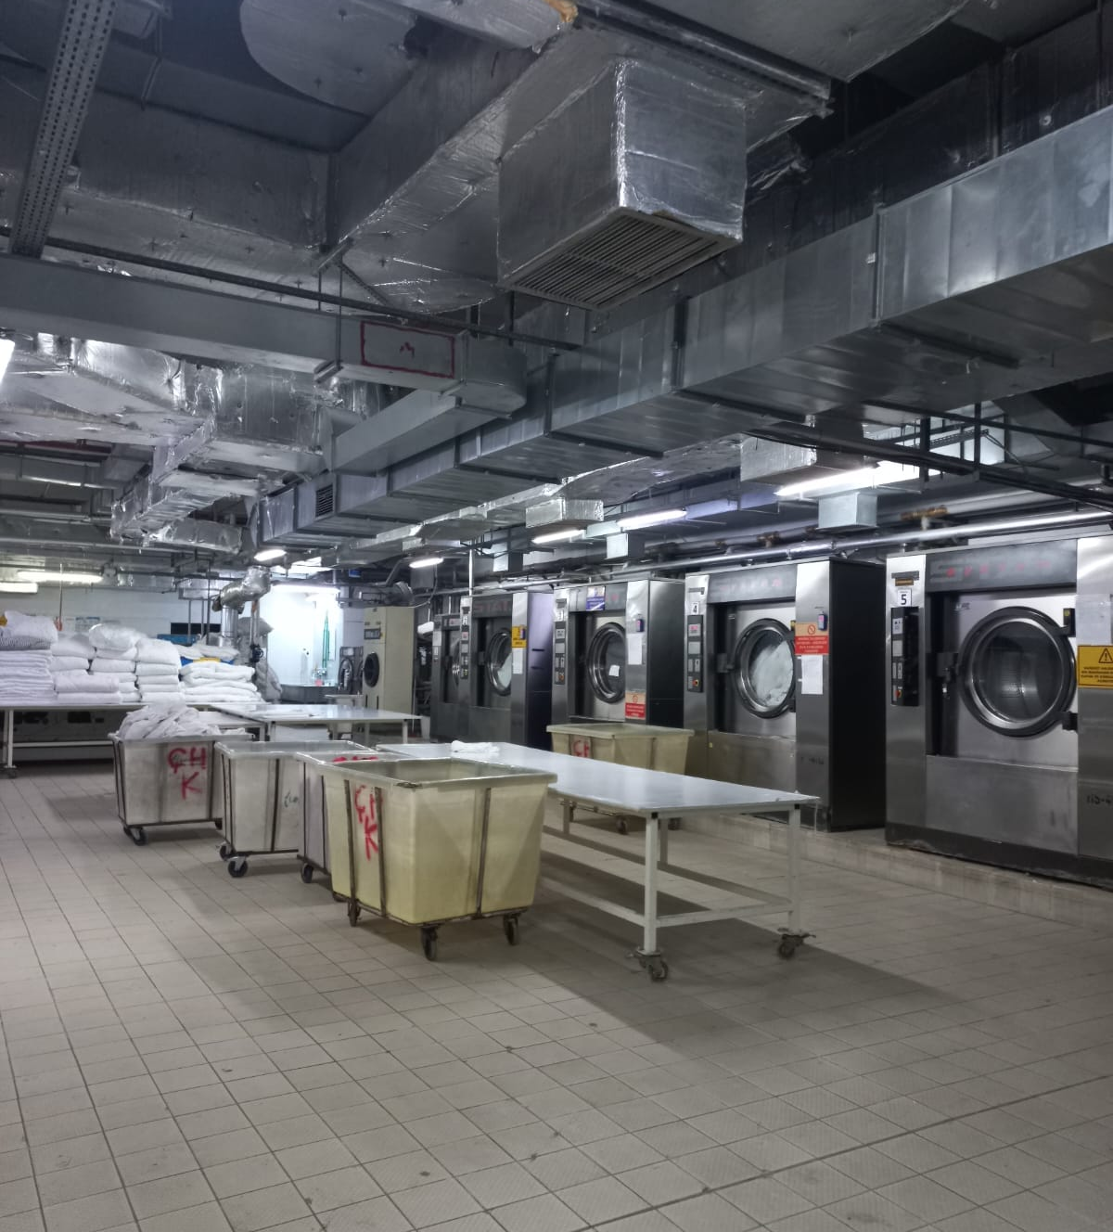
Current Situation
The laundry is located on-site and is used to wash towels, blankets, and uniforms.
Meanwhile sheets, bed linens, tablecloths, napkins, and pillowcases are washed through external service procurement.
Notes:
We're working for a group of companies that own 7 all-inclusive hotels in Antalya. We selected one pilot hotel.
Firstly, we assessed the current situation in our selected pilot hotel.
We determined the number of machines on-site.
We also provided answers to questions such as the number of staff in the laundry department and the overall costs associated with the laundry operations.

Slide 10
Analysis of the Current Situation
Machines | Capacity (kg) | Number | Working Condition
Washing Machine | 110 | 4 | Operational
Drying Machine | 75 | 4 | Operational
Dry Cleaning Machine | 12 | 1 | Not Working
Wall Ironer |  | 1 | Faulty but Repairable
Towel Folder Machine |  | 1 | Faulty but Repairable
Notes:
After determining the current situation, we started to analyze it.
You can see the operational status of some machines in the pilot hotel on the screen.
Here we identified which ones are operational, which ones are faulty but repairable, and which ones are not working.

Slide 11
Overall Costs
Water
Electricity
Steam
Detergent
Technical Service - Maintenance/Repair
Technical Service - Fault
Personnel
Other Indirect Costs (Booklet, Printed Documents, Non-washing Electricity Usage, Material Deformation, etc.)
Notes:
Now we need to determine the budget required to wash one kilogram of laundry. We will look at the costs associated with the current capacity. These costs will be necessary to decide on the optimal option in the project solution.
You are currently seeing various cost categories associated with the laundry department.
During this process, we also conducted research on machine prices to establish a cost range.

Slide 12
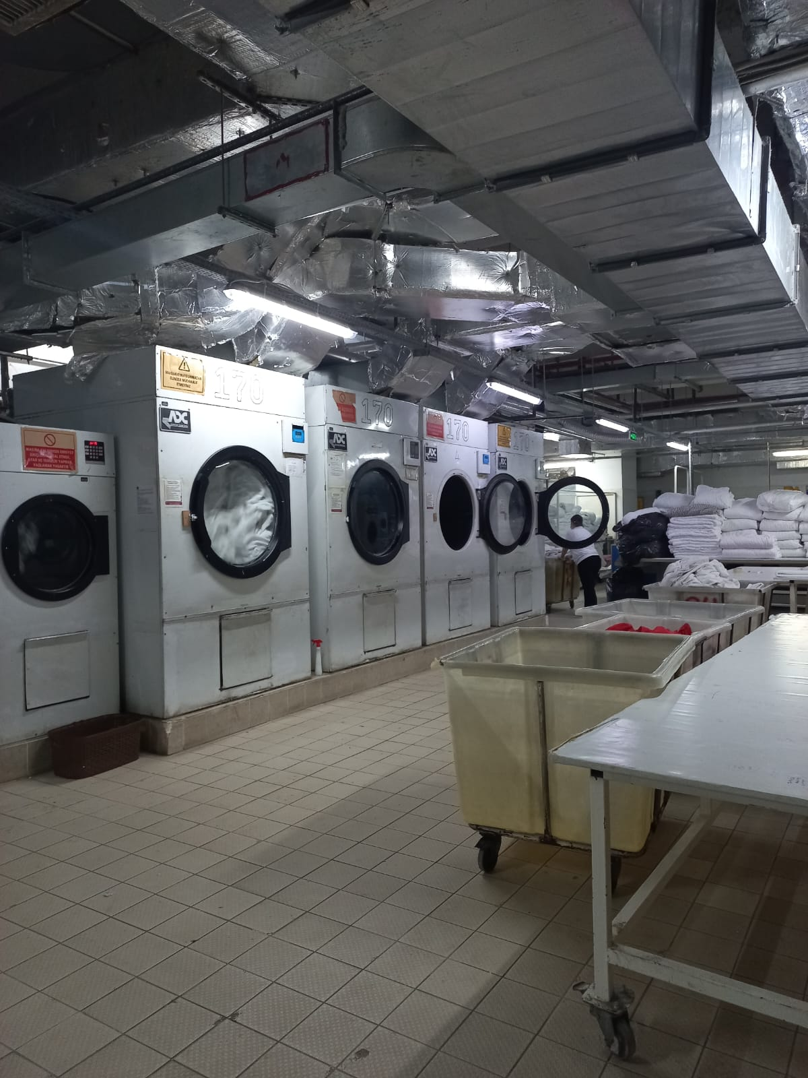
Capacity Study
how many kilograms of laundry we can wash per day
and how many kilograms of laundry should be washed
Notes:
After all these stages, we began to conduct capacity studies.
Capacity study is instrumental in identifying opportunities for improvement, streamlining operations, and ensuring that a laundry department operates at its full potential.
During the ongoing capacity study, we address questions such as how many kilograms of laundry we can wash per day with the current machines, and how many kilograms of laundry should be washed. In this context, we conduct capacity studies on various issues such as machines, staff, and laundry area.

Slide 13
Work and Time Studies
Start Time | End Time | Product | Machine | Task Duration
13:36 | 14:27 | Towel-Robe | Drying Machine | 0:51:00
13:41 | 14:13 | Uniform | Washing Machine | 0:32:00
14:00 | 14:48 | Towel-Robe | Washing Machine | 0:48:00
14:15 | 14:51 | Pillowcase | Drying Machine | 0:36:00
14:19 | 15:13 | Towel-Robe | Drying Machine | 0:54:00
Notes:
At this point, it is crucial to determine how long it takes for the machine to complete laundry process and how long it takes for the staff to complete their workflow. You are currently seeing some machine time study works on the screen
Analyzing these time-related factors allows for better planning, resource allocation, and optimization of the laundry processes to enhance overall operational efficiency and customer satisfaction.
In this phase, we conducted work and time studies, analyzing the existing machines optimal usage through time studies for improved efficiency.

Slide 14
Analysis of the Possibility of Conducting Outsourced Services Within the Facility
Notes:
We've seen Determination of the Current Situation now let's take a look at Analysis of the Possibility of Conducting Outsourced Services Within the Facility

Slide 15
Determine the Number and Capacity of Additional Machines
machines are sufficient?
we will determine the number of additional machines
Establish the Required Rumber of Personnel - Scheduling
number of personnel
shift system
shift scheduling optimization
Adequacy of the Laundry
laundry space
optimizing the laundry
better utilize the existing working environment
Notes:
In the future stages, based on capacity calculations, we will clarify whether the existing machines are sufficient. If not, we will determine the number of additional machines needed. Here we will determine the kilograms of products to be washed in one day, assuming the maximum number of daily stays in the hotel.
Simultaneously, we will establish the required number of personnel and the shift system to operate at full capacity. Additionally, a shift scheduling optimization will be conducted.
n the final stage, the adequacy of the laundry space will be examined. Even under current usage conditions, there is insufficient space. Therefore, optimizing the laundry area is necessary to better utilize the existing working environment and ensure sufficient space if additional machines are added.

Slide 16
Suggested Solutions of the Problem
Notes:
we will now move on to Suggested Solutions of the Problem

Slide 17
Deciding on the Optimum Option
1. Keep current situation
  Wash towels, blankets, and uniforms on-side
  Washed through external service sheets, bed linens, tablecloths, napkins, and pillowcases
  Capacity, cost
2. All laundry operations to be within the facility
  Capacity, cost, shift scheduling, laundry area
3. Outsourcing all laundry operations
    Cost – price offer
Notes:
After completing all stages, a decision will needs to be made for the optimal use of laundry facilities.
Upon examining this situation, we have three options: Keep the current situation, Bring all laundry operations within the facility, and Outsource all laundry operations.
Along with our research, a decision will be made by evaluating the company's cost-benefit situation.

Slide 18
Further Research
Notes:
and finally, we will see into further research.

Slide 19
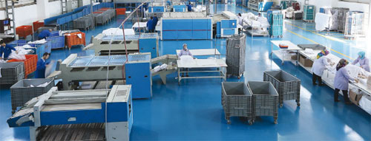
Common Laundry Facility
facility location,
facility planning,
logistics network problems,
managinig joint processes
Notes:
We selected a pilot hotel and worked there; Since the same problems exist in the other hotels owned by the group company and we will work on resolving these issues for the other hotels as well.
At this point, establishing a common laundry facility for all hotels is being considered.
If a common laundry facility is established, it will be necessary to address issues such as facility location, facility planning, and logistics network problems.

Slide 20
Thanks!
Do you have any questions?
aybukesahin@std.antalya.edu.tr
sulgen@antalya.edu.tr
secil.gulbudak@gmail.com
Notes:
In our presentation, we discussed a series of important topics related to hotel laundry optimization. We talked about determining the current situation, analyzing the possibilities of using external resources within the facility, solving problems, and conducting further research.
In this presentation, I have provided you with information about the existence of such an important problem and how it will be addressed. After completing the project, I will write a paper about the results of this project. In the project process, there are still ongoing stages, and we have not achieved a finalized result.
However, the preliminary information obtained about the current state of the project and ongoing research indicates the necessity for a more detailed analysis and evaluation. Currently, considering the data obtained during the project process, we aim to reach more comprehensive conclusions in the upcoming stages.
I express my gratitude to the project team and everyone who contributed. İf you have any questions I would be happy to answer.

